Slide 1
SENTIMENT ANALYSIS ON IMDB DATASET
Presented by: Sharanya
Project Guide: Dr. Manjaiah D.H

Slide 2
ABSTRACT:
From the last 10 years, popularity of social media has increased at an alarming rate. Everyone is utilizing technology at higher rates than earlier. People are now sharing their emotions and opinions on social media sites allowing others to know what they think about a particular thing. Researchers in the fields of natural language processing (NLP) and machine learning (ML) have explored a variety of methods to implement the process with highest accuracy possible. Huge textual data is available on sites like Amazon, IMDB, and Rotten Tomatoes on movies and analyzing such massive data manually is a tedious task. So, to speed up the process, programmers use certain techniques to extract out public opinion. One of which is using sentiment analysis.
Sentiment analysis can be defined as analyzing the positive or negative sentiment of the customer in text. The contextual analysis of identifying information helps businesses understand their customers’ social sentiment by monitoring online conversations.
Analyzing customer feedback and reviews automatically through survey responses or social media discussions allows you to learn what makes your customer happy or disappointed. Further, you can use this analysis to tailor your products and services to meet your customer’s needs and make your brand successful.

Slide 3
STATEMENT OF PROBLEM:
A basic task in sentiment analysis is classifying the polarity of a given text at the document, sentence, or feature/aspect level — whether the expressed opinion in a document, a sentence or an entity feature/aspect is positive, negative. Advanced, “beyond polarity” sentiment classification looks, for instance, at emotional states such as “angry”, “sad”, and “happy”.
In this, we have to predict the number of positive and negative reviews based on sentiments by using different classification models.
The goal of sentiment analysis is to determine the attitude of a speaker or writer based on the language they use regarding a specific topic or product. Various platforms can be used to analyze whether a sentiment is positive, or negative.

Slide 4
OBJECTIVES:
The objective of sentiment analysis is to accurately extract people's opinions from a large number of unstructured review texts and classifying them into sentiment classes, i.e., positive, negative.
It can be used to determine the attitude of the reviewer with respect to various topics or the overall polarity of review. Using sentiment analysis, we can find the state of mind of the reviewer while providing the review and understand if the person was “happy”, “sad”, “angry” and so on.
We analyze and study the features that affect the sentiment score of the movie review text. Also, we use the state of the art classification algorithms for the evaluation of performance and accuracy of the approach used.
In today’s world, lot of data created every day in the form of messages, posts, and reviews. All these raw texts can be extracted or collected in various ways for understanding the sentiments and conduct sentiment analysis.

Slide 5
LITERATURE REVIEW:
The online movie review data collected from IMDB dataset, the box office collection and the success or failure of the movie is predicted based on the reviews. Pang et al applied the machine learning technique for classification of reviews present on IMDB movie reviews database, by forming the list of 14 keywords which are useful in finding the baseline for classification accuracy.
A Large number of works have been carried out previously on opinion mining and sentiment analysis. Nagamma P et al proposed various data mining techniques for classification of movie audits and it likewise predicts the box office collection for the movie.

Slide 6
‘The authors proposed to apply eight classifiers on the IMDb movie reviews dataset. These are - Naive Bayes, Decision Tree, Random Forest, Ripple Rule Leaning, K- Nearest Neighbors, Support Vector Classifier, Bayes Net, Stochastic Gradient Descent. In their work Ripple Rule Learning was found give the worst results, whereas Random Forest outperformed other classifiers. Performance of these eight classifiers were measured by five different evaluation metrics, namely, Accuracy, Area Under Curve (AUC), F1- measure, Recall, and Precision. Authors of were of the thought that reviews of movies shared on social media platforms and other web portals are important factors in a movie’s financial success. The results showed that positive sentiment is more efficient for a movie domain with a small number of existing reviews, which indicated that sentiment alone is not the only factor. Rather, sentiment could perform better in combination with other factors such as movie genre and festive season etc.

Slide 7
LIMITATIONS OF THE STUDY:
1. Tone: Tone can be difficult to interpret verbally, and even more difficult to figure out in the written word. Things get even more complicated when one tries to analyze a massive volume of data that can contain both subjective and objective responses.
2. Sarcasm: People use irony and sarcasm in casual conversations and memes on social media. The act of expressing negative sentiment using backhanded compliments can make it difficult for sentiment analysis tools to detect the true context of what the response is actually implying.
3. Idioms: Machine learning programs don’t necessarily understand a figure of speech. For example, an idiom like “not my cup of tea” will boggle the algorithm because it understands things in the literal sense. Hence, when an idiom is used in a comment or a review, the sentence can be misconstrued by the algorithm or even ignored.
4. Negations: Negations, given by words such as not, never, cannot, were not, etc. can confuse the ML model. For example, a machine algorithm needs to understand that a phrase that says, “I can’t not go to my class reunion”, means that the person intends to go to the class reunion.
5. Comparative Sentences: Comparative sentences can be tricky because they may not always give an opinion. Much of it has to be deduced.

Slide 8
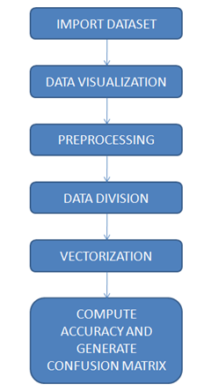
METHODOLOGY:

Slide 9
IMPORT DATASET:
For this project a data set containing 1500 movie reviews from IMDb dataset, created by Andrew Maas is utilized. The reviews are classified into positive and negative in reference to the IMDB rating system. It allows viewers to rate on a scale from 1 to 10, and according to dataset creator anything ≤ 5 stars is labelled negative and ≥ 6 stars is marked as positive.
DATA VISUALIZATION:
Data visualization is a field in data analysis that deals with visual representation of data. It graphically plots data and is an effective way to communicate inferences from data. Python offers several plotting libraries, namely Matplotlib, Seaborn and many other such data visualization packages with different features for creating informative, customized, and appealing plots to present data in the most simple and effective way.

Slide 10
PREPROCESSING:
Data that are not well cleaned and organized might lead to false identifications. Hence, data pre-processing is a crucial task in the data mining process. It refers to cleaning up the data from useless information that will not help in the training process and might cause confusion during the classification process. For the IMDB dataset, several data pre-processing steps are utilized. Firstly, all the symbols such as “?”, “!” are removed. Secondly, all letters in the dataset are converted into lowercase letters. Thirdly, all hybrid links are removed from the text. Fourthly, stop words such as, me, you, and we are evicted. Finally, stemming techniques are applied on the text to present the word in its original form after removing prefixes and suffixes.
DATA DIVISION:
It is common to divide the dataset into training and testing dataset .The training dataset is the set of data that trains the considered classifier. Test data is to evaluate the model accuracy. The split of the training and validation, testing, or both can occur in many ways. However, there is a rule-of-thumb that training gets the most data. A recurrent ratio encountered in various eclectic ML settings is the 70-30 split which gives 70% to the training and 30% to the testing. In order to avoid any biasness an equal representation of positive and negative reviews is employed, 70% of this data is used for the training purpose and the 30% is used for the testing purpose.

Slide 11

VECTORIZATON:
Vectorization or text embedding is the process of extracting features from text and pass it as an input to the classifier. Python is a general purpose object-oriented high level programming language. Due to the extensive libraries and frameworks dedicated to ML which facilitates the development process and save time, it is considered and used in this project. Each movie review is encoded “vectorized” into a numeric value.
COMPUTE ACCURACY:
The classification accuracy is used to measure that how well the devised model is able to automatically identify the data. It is the percentage of labels that have been correctly classified. The mathematical formulation for accuracy is given in Equation below. Where, TP, TN, FP, and FN respectively denote the true positives, true negatives, false positives, and false negatives in the predicted labels.

Slide 12
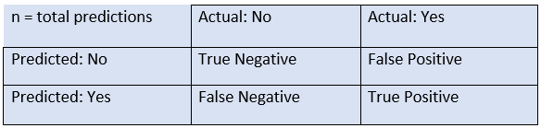
CONFUSION MATRIX:
True Negative: Model has given prediction No, and the real or actual value was also No.
True Positive: The model has predicted yes, and the actual value was also true.
False Negative: The model has predicted no, but the actual value was Yes
False Positive: The model has predicted Yes, but the actual value was No.

Slide 13
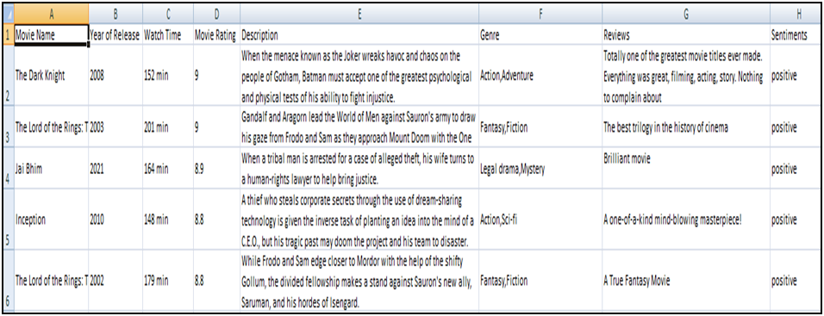
DATA DESCRIPTION:
In our project we use “IMDB Movie dataset” for analysis of sentiment on movie review for positive and negative accuracy results.

Slide 14
ATTRIBUTE INFORMATION:
Movie Name: This attribute provides the details of name of the movie.
Year of release: Attribute gives the information of year in which movie released.
Watch time: The duration of movie runtime is specified in this column.
Movie Rating: The ratings given by the viewers are provided.
Description: Movie descriptions are specified in this column.
Genre: Contains Category of the movie.
Reviews: This column provides the details regarding the reviews of a movie.
Sentiment: Feelings expressed by the reviewers are specified in this attribute.

Slide 15
ALGORITHMS USED:
usof a dataset, branches represent the decision rules and each leaf node represents the outcome. It is a graphical representation for getting all the possible solutions to a problem/decision based on given conditions. It is called a decision tree because, similar to a tree, it starts with the root node, which expands on further branches and constructs a tree-like structure.
Support Vector Machine:
SVM algorithm is used to create the best line or decision boundary that can segregate n-dimensional space into classes so that we can easily put the new data point in the correct category in the future.
This best decision boundary is called Hyperplane.
SVM chooses the extreme points/vectors that help in creating the hyperplane.
These extreme points are called as Support Vectors and hence the algorithm is termed as Support Vector Machine.
Decision Tree Classification:
Decision Tree is a supervised learning technique that can be used for both classification and Regression problems.
It is a tree-structured classifier, where internal nodes represent the features of a dataset, branches represent the decision rules and each leaf node represents the outcome.
It is a graphical representation for getting all the possible solutions to a problem/decision based on given conditions. It is called a decision tree because, similar to a tree, it starts with the root node, which expands on further branches and constructs a tree-like structure.

Slide 16
Naïve Bayes:
It is a classification algorithm, primarily used for text classification involving high dimensional training data sets. Example spam filtering, sentiment analysis etc.
This algorithm learns the probability of an object with certain features belonging to a particular class. It is a probabilistic classifier.
This algorithm is called Naive Bayes because it makes a naive assumption that occurrence of certain features is independent of each other which in reality is not the case.
Logistic Regression:
Logistic regression is quite similar to linear regression but here, instead of fitting a line to our data we try to fit ‘S’ shaped logistic function(Sigmoid Function).
Although it’s name contains regression, on the contrary it is used for classification purposes. Logistic regression’s capability to classify data using continuous and discrete measurements makes it a popular machine learning algorithm.
It can be used to classify samples and can use different kinds of data to classify samples. It can also be used to assess what variables are useful for classifying samples.

Slide 17
COMPUTED ACCURACY:
ALGORITHM 1: SVM ALGORITHM
ALGORITHM 2: DECISION TREE ALGORITHM

Slide 18
ALGORITHM 4: LOGISTIC REGRESSION ALGORITHM​
ALGORITHM 3: NAIVE BAYES ALGORITHM​

Slide 19
CONCLUSION:
In this work, we extracted new features that have strong impact on determining the polarity of the movie reviews and applied computation methods for pre-processing of the data.
Sentiment analysis also referred to as opinion mining is the process of extracting opinions from text data and classifies it into positive or negative.
FUTURE SCOPE:
In future, we would like to evaluate the effectiveness of the proposed sentiment classification features and techniques for other tasks, such as sentiment classification. We would like to apply in-depth concepts of NLP for better prediction of the polarity of the document. We would also like to extend this technique on other domains of opinion mining like’s newspaper articles, product reviews, political discussion Forums etc. This research can be expanded to include the analysis of online feedback from social media platforms and other sophisticated algorithms.

Slide 20
REFERENCES:
[1] Saeed MianQaisar-Sentiment Analysis of IMDb Movie Reviews Using Long Short-Term Memory,College of Engineering, Effat University, 21478, Jeddah, Saudi Arabia.​
[2] Abhimanyu Singh -Sentiment Analysis of IMDB Movie Reviews, SUNY Binghamton.​
[3] KamilTopal-Movie Review Analysis: Emotion Analysis of IMDb Movie Reviews, Electrical Engineering and Computer Science Case Western Reserve University Cleveland.​
[4] Tirath Prasad Sahu- Sentiment Analysis of Movie Reviews: A study on Feature Selection & Classification Algorithms, National Institute of Technology Raipur, India​

Slide 21
THANK YOU

